Slide 1

Component Identification, Pneumatic Diagrams and Best Practices
Mater Dei Robotics

Slide 2
Agenda
Mater Dei Robotics
Advantages and Disadvantages
Component Identification
Pneumatic Diagrams
Best Practices

Slide 3

Advantages and Disadvantages of Pneumatics
Advantages
Adjustable force up to 190 lbs by size of cylinder, working pressure, more with mechanical advantage
Simple implementation and addition of cylinders, lighter than an equivalent motor
Takes abuse w/o damage. Absorbs shock loads very well.
Final movement is possible after robot is disabled w/return to single solenoid's home position
Minuses
Initial weight, primarily the 4.8 lbs of the compressor
Two positions extended/retracted (some in-between is possible with special pistons)
Disabled or weakened by loss of pressure
More limits to power than motors
Must be protected from side impacts. Cylinder walls are thin and small dings can stop movement.
Actuators do not handle or like side loads-push or pull direction only.

Slide 4
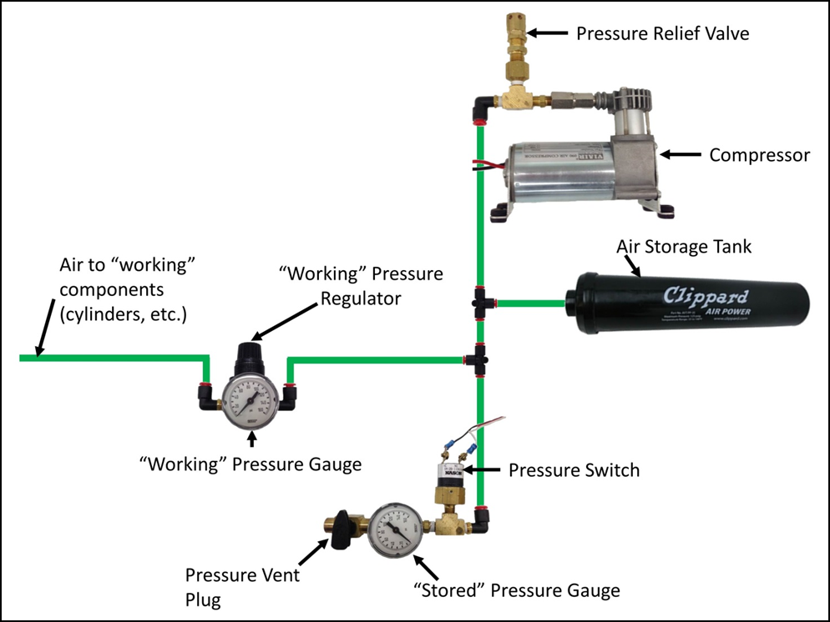
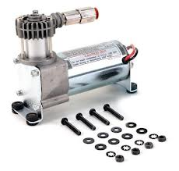
Component Identification

Slide 5

Component Identification
120 psig set pressure

Slide 6
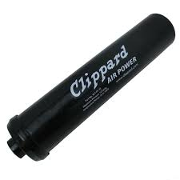
Component Identification

Slide 7
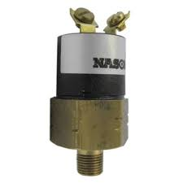
Component Identification

Slide 8
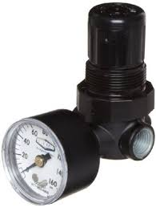
Component Identification
Inlet: 120 psig
Outlet: 60 psig

Slide 9
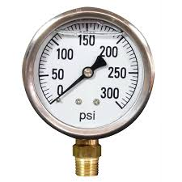
Component Identification

Slide 10
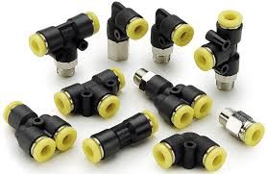
Component Identification

Slide 11
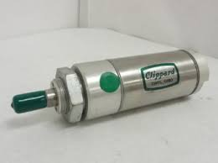
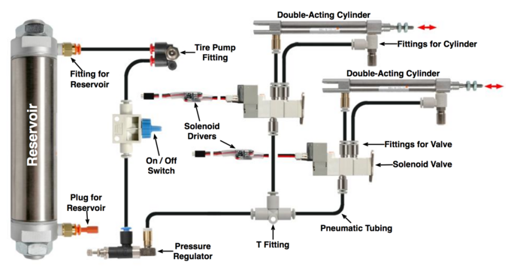
Component Identification

Slide 12
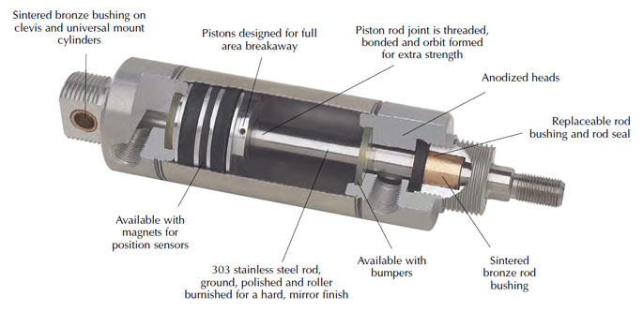
Component Identification

Slide 13
Component Identification

Slide 14
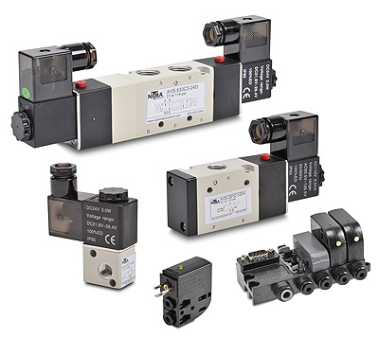
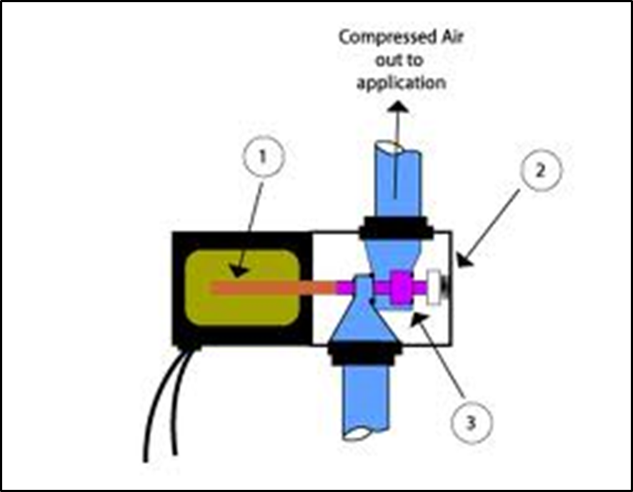
Component Identification

Slide 15
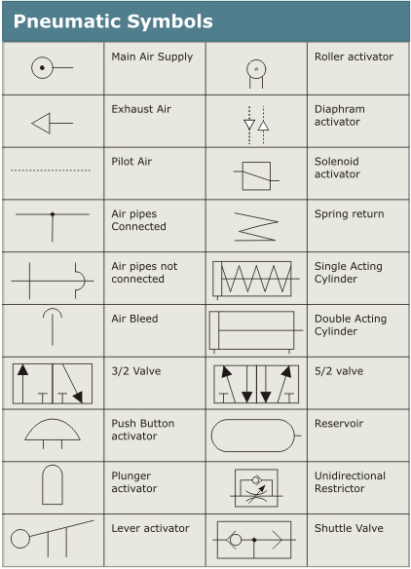
Pneumatic Diagrams

Slide 16
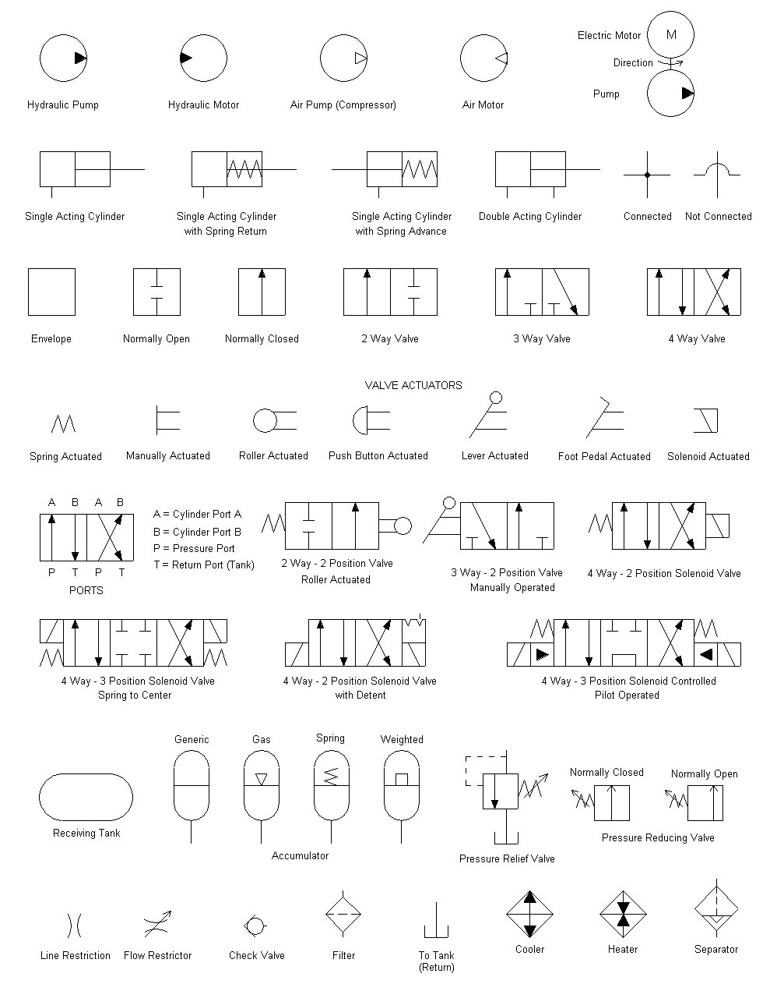
Pneumatic Diagrams

Slide 17
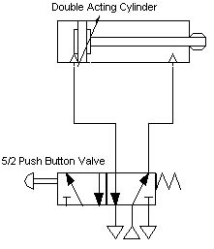
Pneumatic Diagrams

Slide 18
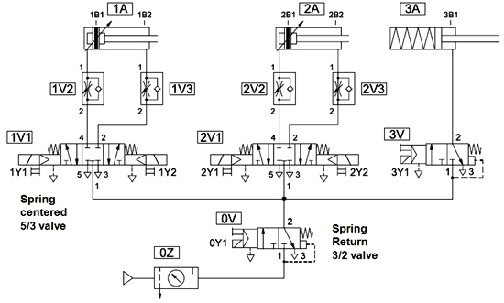
Pneumatic Diagrams

Slide 19
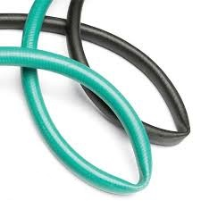
Best Practices
Pneumatics are linear devices. Avoid side loads and rotation
Route tubes away from pinch-points
Keep tubes as short as practical
Maintain proper bend radius

Slide 20
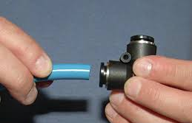
Best Practices
Pneumatics are linear devices. Avoid side loads and rotation
Route tubes away from pinch-points
Keep tubes as short as practical
Maintain proper bend radius
Cut ends of tubes square

Slide 21
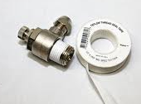
Best Practices
Pneumatics are linear devices. Avoid side loads and rotation
Route tubes away from pinch-points
Keep tubes as short as practical
Maintain proper bend radius
Cut ends of tubes square
Apply Teflon® tape to threads, leaving bottom two threads uncovered

